Slide 1
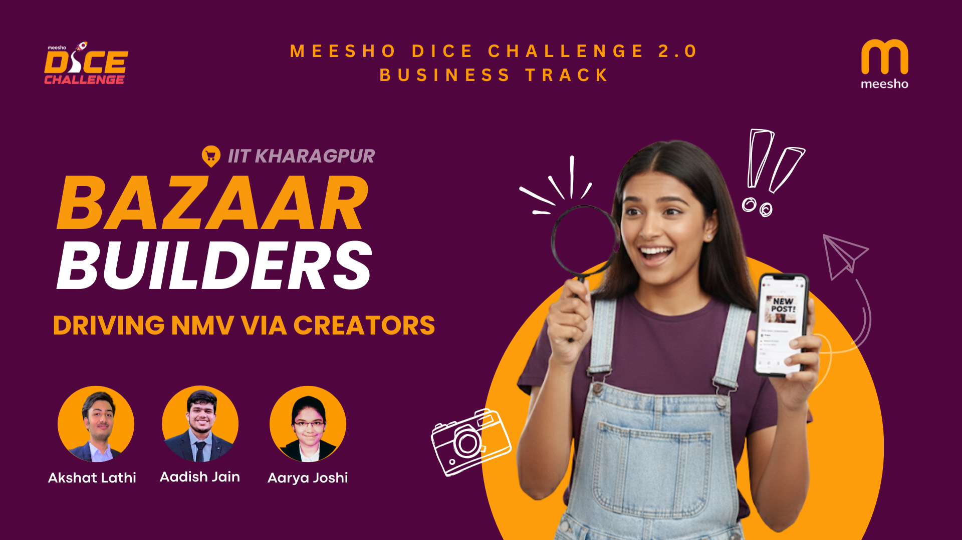

Slide 2
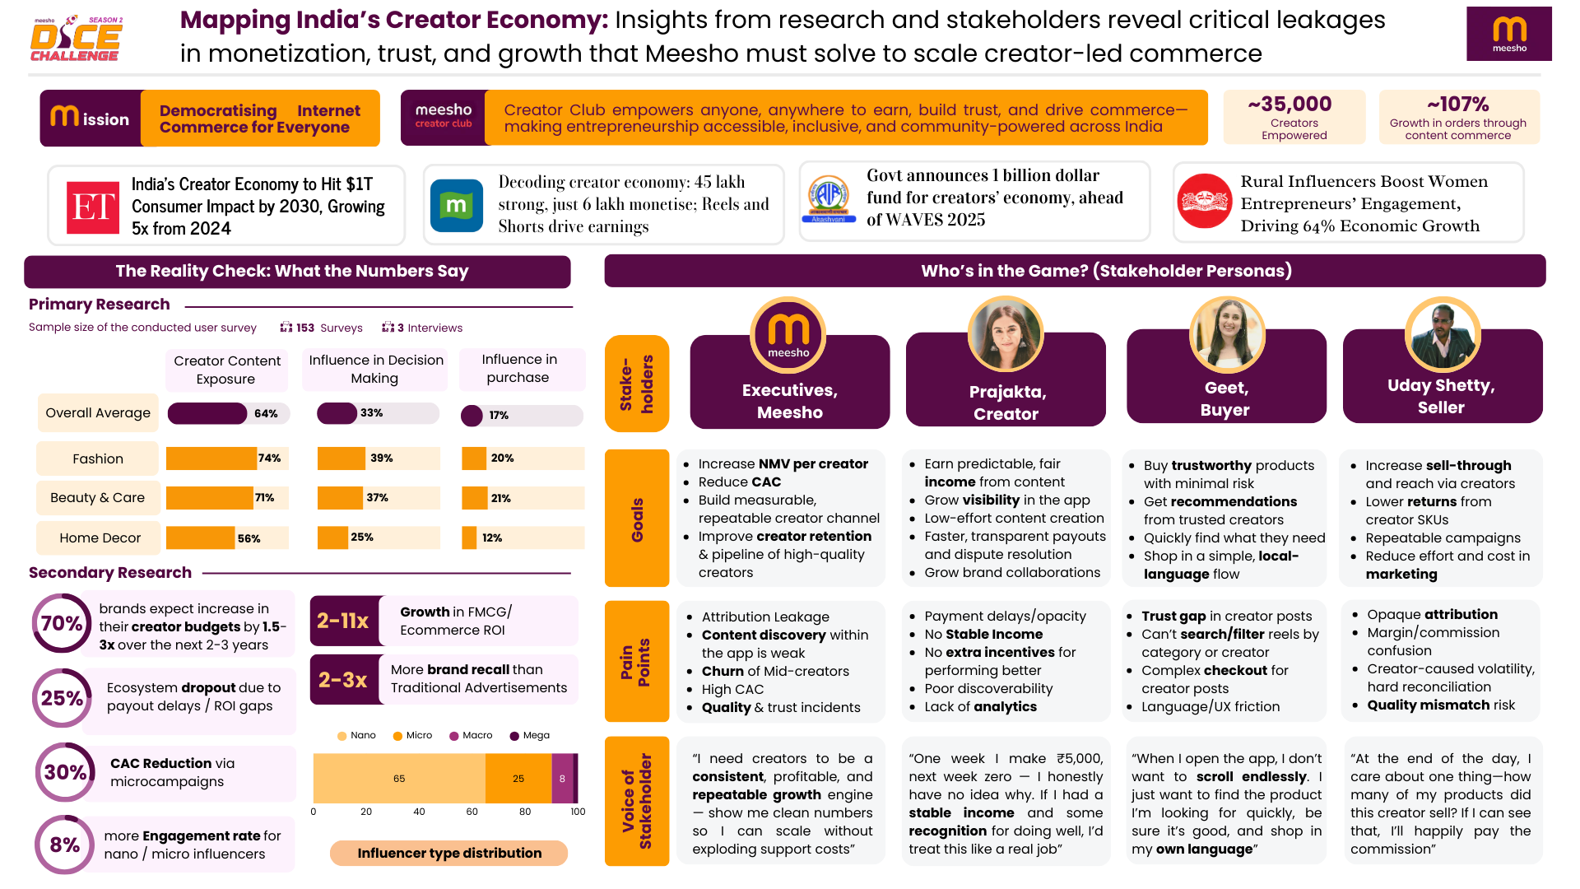

Slide 3
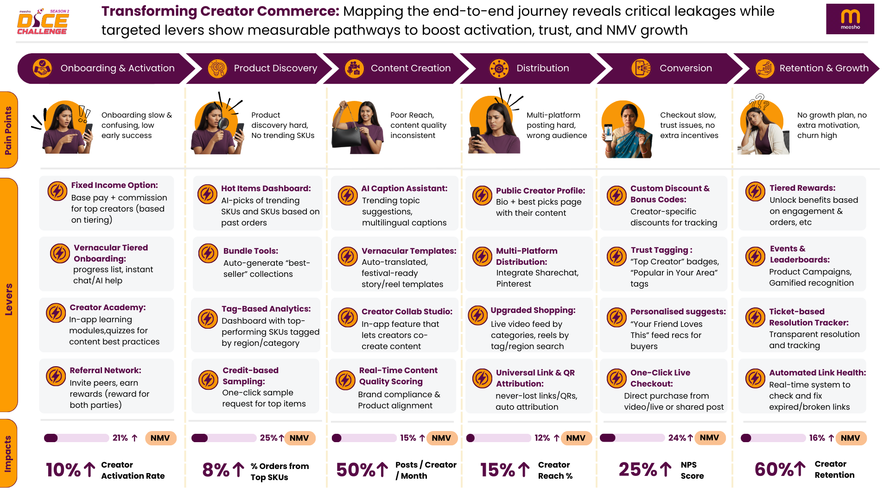

Slide 4
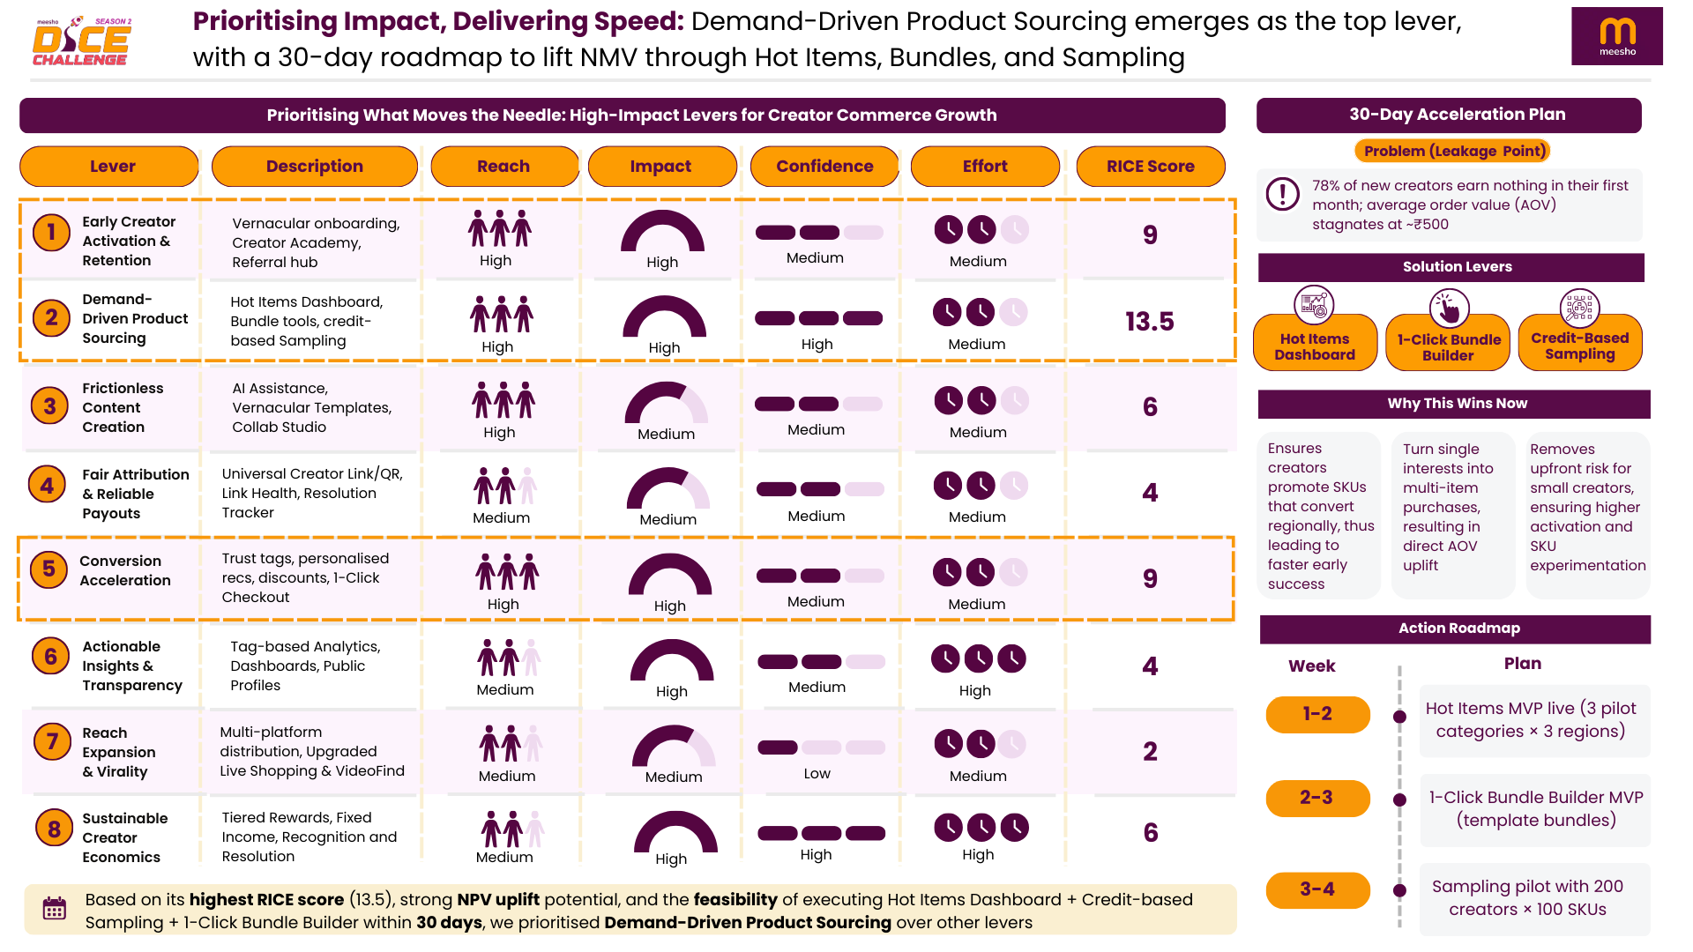

Slide 5
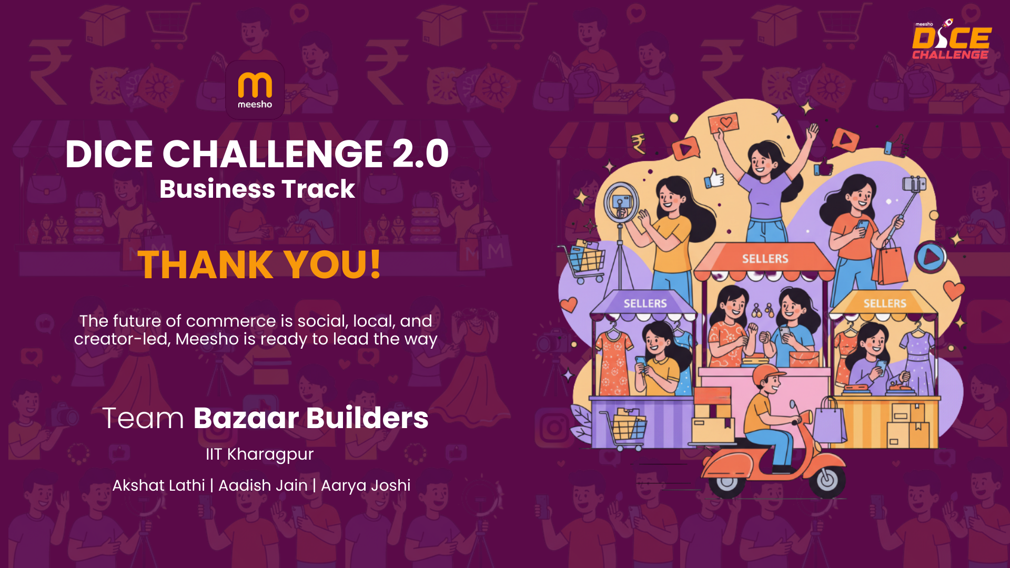

Slide 6
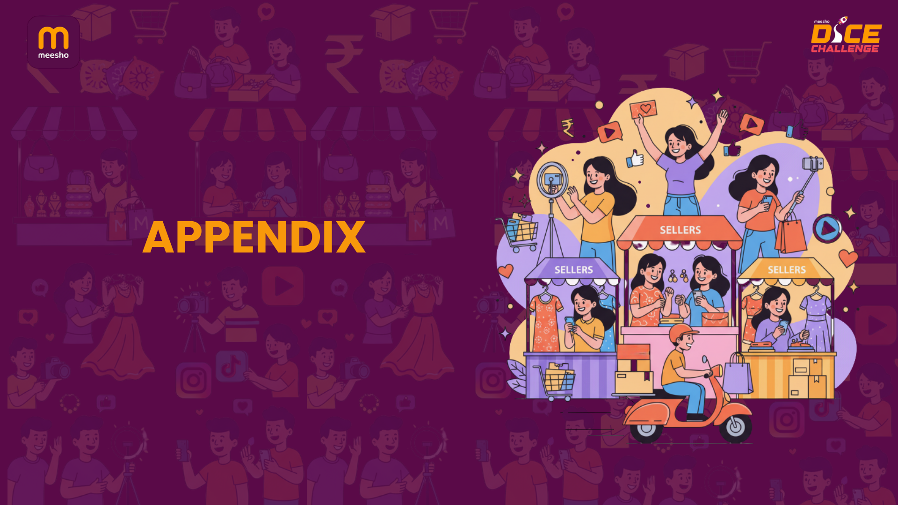

Slide 7
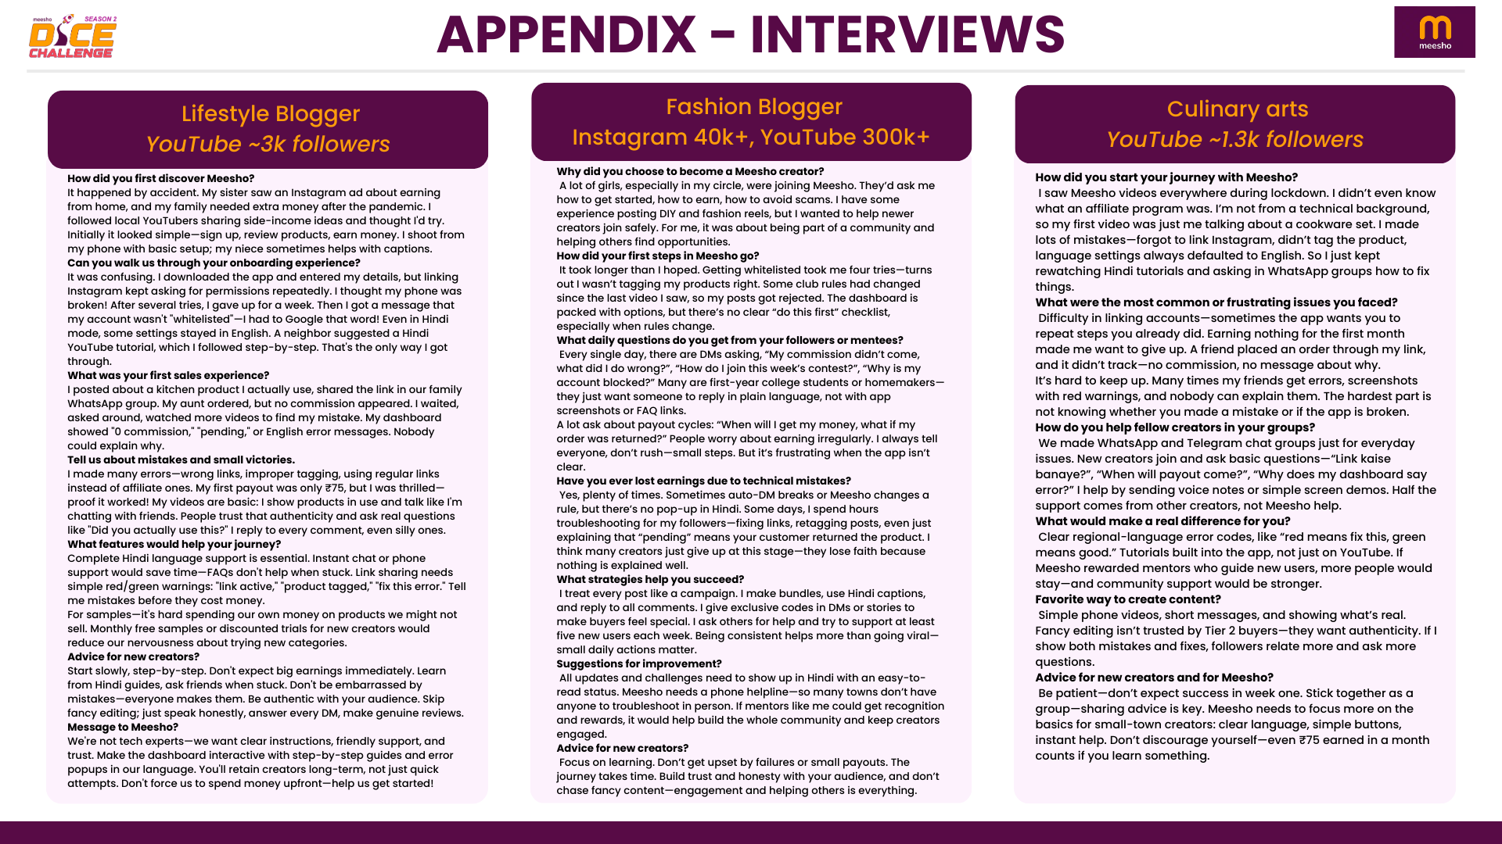

Slide 8
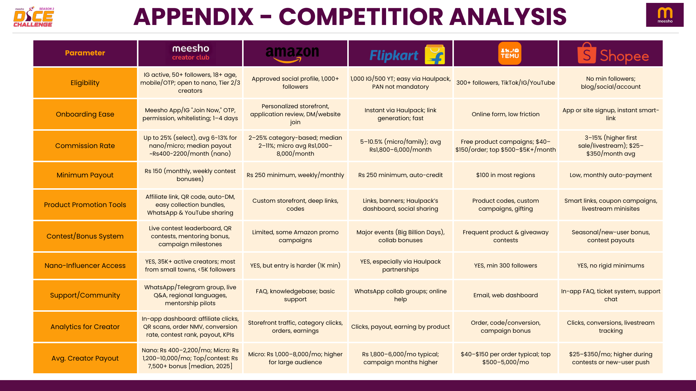

Slide 9
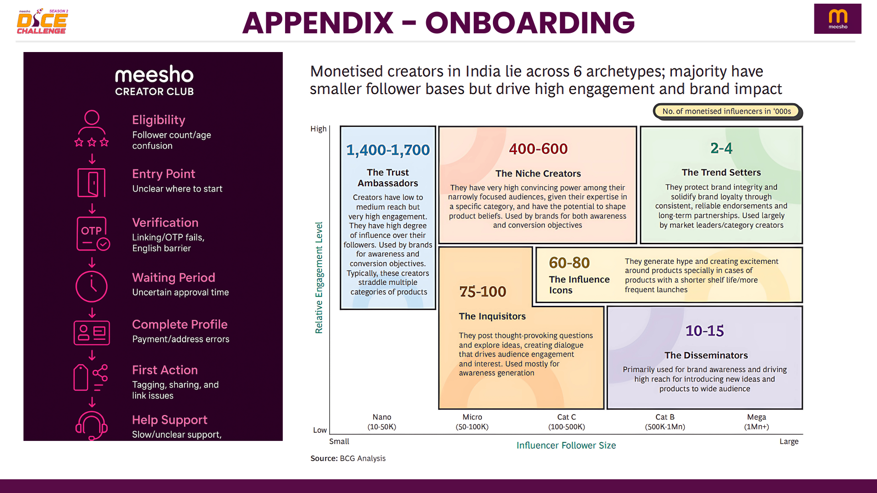

Slide 10
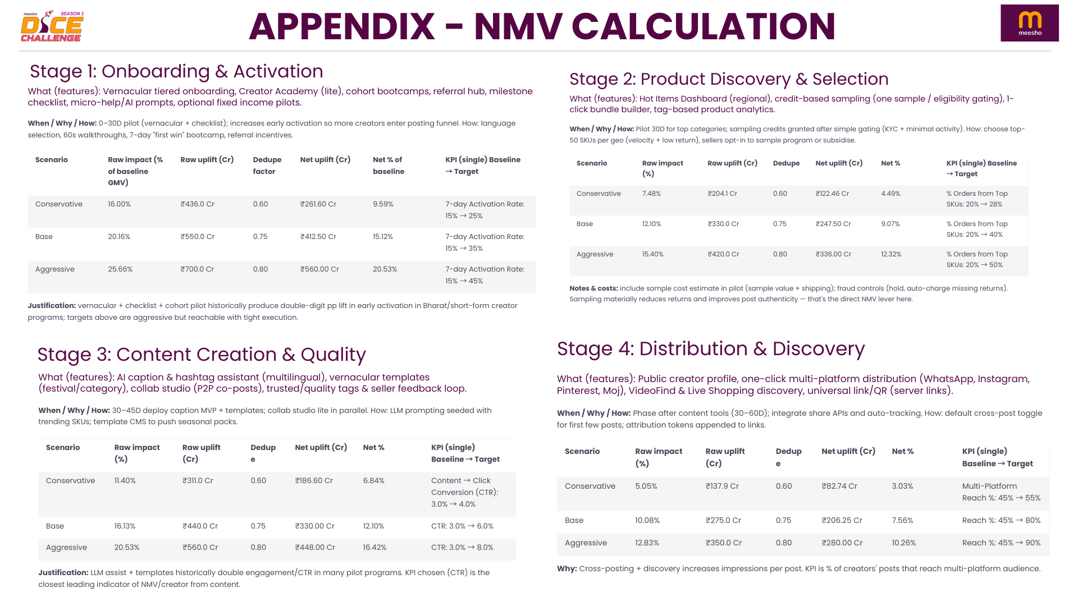

Slide 11
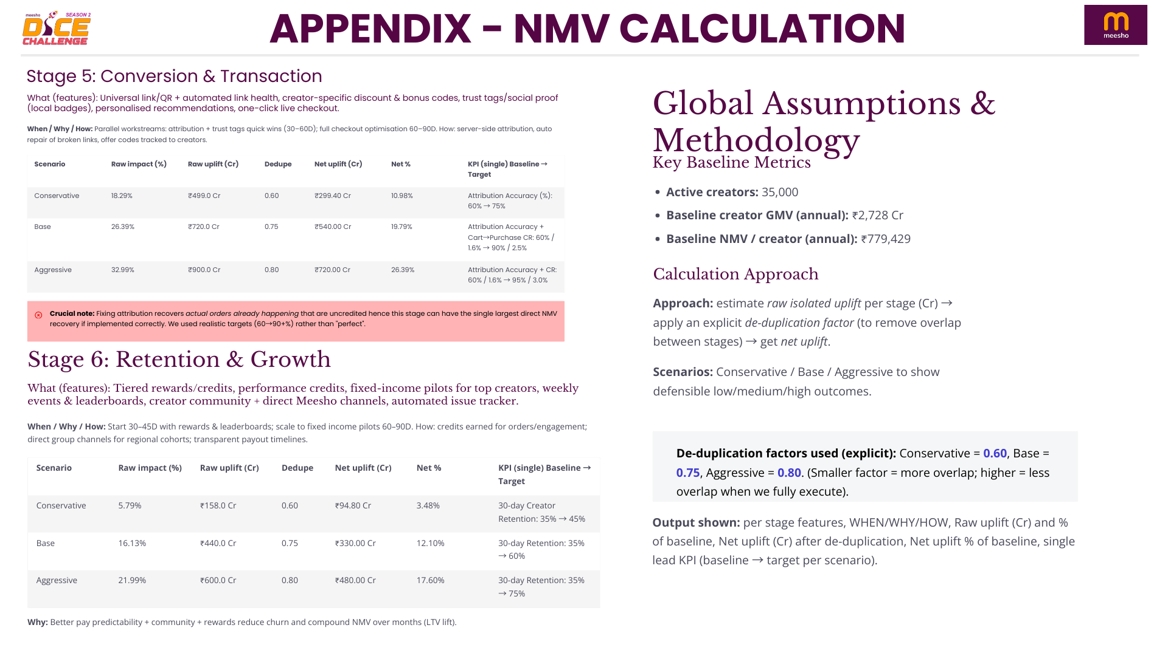

Slide 12

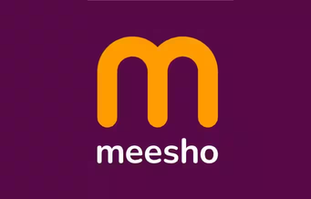
APPENDIX - REFERENCES
https://www.newsonair.gov.in/govt-announces-1-billion-dollar-fund-for-creators-economy-ahead-of-waves-2025/
https://www.moneycontrol.com/news/trends/decoding-creator-economy-45-lakh-strong-just-6-lakh-monetise-reels-and-shorts-drive-earnings-13240529.html
https://www.newindianexpress.com/magazine/2024/Apr/20/from-village-to-viral-indias-heartland-influencers-reshape-social-media-landscape-2
https://economictimes.indiatimes.com/industry/media/entertainment/media/creator-economy-is-worth-a-billion-bucks-still-growing/articleshow/120833671.cms?from=mdr
Meesho Launches Creator Club: Content Commerce Platform - Rediff Money, accessed September 14, 2025, https://money.rediff.com/news/market/meesho-launches-creator-club-content-commerce-platform/22452420250219
Meesho Launches Creator Club to Boost Content Commerce Growth - Indian Retailer, accessed September 14, 2025, https://www.indianretailer.com/news/meesho-launches-creator-club-boost-content-commerce-growth
Meesho launches creator marketplace to pump influencer-driven sales, accessed September 14, 2025, https://entrackr.com/snippets/meesho-launches-creator-marketplace-to-pump-influencer-driven-sales-8736217
Meesho Launches Content Commerce Platform Creator Club - Outlook Business, accessed September 14, 2025, https://www.outlookbusiness.com/corporate/meesho-launches-content-commerce-platform-creator-club
Meesho Unveils One Of India's Largest Creator Marketplaces - BW ..., accessed September 14, 2025, https://bwretailworld.com/sector/e-commerce-marketplaces/meesho-unveils-one-of-indias-largest-creator-marketplaces
How to Start Meesho Influencer Program Make Money in 2025 - HaulPack, accessed September 14, 2025, https://www.haulpack.com/blog/meesho-affiliate-marketing-earnings-for-influencers/
Meesho Affiliate Program – Get Started Today - Octaads Media, accessed September 14, 2025, https://octaadsmedia.com/our-blog/meesho-affiliate-program-get-started-today/
Meesho Affiliate Program: Registering to Earning Commissions Online - Cuelinks, accessed September 14, 2025, https://www.cuelinks.com/blog/meesho-affiliate-program-a-complete-guide-from-registering-to-earning-commissions-online/
Meesho Affiliate Program India Guide (2025 Update) - The DM School, accessed September 14, 2025, https://thedmschool.com/meesho-affiliate-program/
Meesho Star Program: Onboard New Sellers with Meesho, accessed September 14, 2025, https://supplier.meesho.com/star
Earn Monthly With Meesho Affiliate Program Using WISHLINK app ..., accessed September 14, 2025, https://www.youtube.com/watch?v=x3wHV8r696s
Meesho launches creator marketplace to accelerate influencer ..., accessed September 14, 2025, https://indianstartupnews.com/news/meesho-launches-creator-marketplace-to-accelerate-influencer-driven-sales-8740610
Meesho collaborates with 21,000 influencers through its creator marketplace, accessed September 14, 2025, https://www.buzzincontent.com/news/meesho-collaborates-with-21000-influencers-through-its-creator-marketplace-8736125
Grow Your Business with Meesho Ads & Seller Tools, accessed September 14, 2025, https://supplier.meesho.com/grow-your-business
Meesho Seller Panel: A Complete Guide for New Suppliers - WareIQ, accessed September 14, 2025, https://wareiq.com/resources/blogs/meesho-seller/
Amazon.in Associates Central, accessed September 14, 2025, https://affiliate-program.amazon.in/
Sign Up for the Amazon Influencer Program, accessed September 14, 2025, https://affiliate-program.amazon.in/influencers
Flipkart Affiliate Program, accessed September 14, 2025, https://affiliate.flipkart.com/
Affiliate Policy - Flipkart, accessed September 14, 2025, https://www.flipkart.com/pages/affiliate-policy
Flipkart Affiliate Program with Payout Upto 12% Per Sale - Cuelinks, accessed September 14, 2025, https://www.cuelinks.com/campaigns/flipkart-affiliate-program
Myntra Influencer Affiliate Program in 2025 - HaulPack, accessed September 14, 2025, https://www.haulpack.com/blog/myntra-influencer-affiliate-program/
How to Become a Myntra Style Squad Member | Step-by-Step Guide - SocioCreator, accessed September 14, 2025, https://sociocreator.com/blogs/how-to-become-a-myntra-style-squad-member/
Amazon Affiliate Program: Complete Earning Guide for 2025 - Shopify, accessed September 14, 2025, https://www.shopify.com/blog/amazon-affiliate-marketing
Commissions - Flipkart Affiliate Program, accessed September 14, 2025, https://affiliate.flipkart.com/commissions
Myntra Affiliate Program with Payout 9% Per Sale | September 2025 - Cuelinks, accessed September 14, 2025, https://www.cuelinks.com/campaigns/myntra-affiliate-program
Content Creators with only Meesho hauls as content? : r/InstaCelebsGossip - Reddit, accessed September 14, 2025, https://www.reddit.com/r/InstaCelebsGossip/comments/16ztd60/content_creators_with_only_meesho_hauls_as_content/
Meesho Case Study: Business Growth, Marketing Tactics, Success Journey, accessed September 14, 2025, https://www.amritsardigitalacademy.in/case-studies/meesho-case-study/
Shein Affiliate Program - iWriter - How to Make $1,000 per Month, accessed September 14, 2025, https://www.iwriter.com/affiliate-programs/shein/
Shein Affiliate Program: In-Depth Review, Pros, and Cons, accessed September 14, 2025, https://www.creator-hero.com/blog/shein-affiliate-program-in-depth-review-pros-and-cons
About SHEIN X Designer Incubator Program - SHEIN Group, accessed September 14, 2025, https://www.sheingroup.com/creators/
How to Join the Temu Influencer Program and Succeed？ - Jogg AI, accessed September 14, 2025, https://www.jogg.ai/blog/how-to-join-temu-influencer-program/
TEMU Affiliate Program Review - Is It Worth The Hype? - Affiverse, accessed September 14, 2025, https://www.affiversemedia.com/the-temu-affiliate-program-a-complete-deep-dive/
Alibaba Affiliate Program - Affiliate program directory - Post Affiliate Pro, accessed September 14, 2025, https://www.postaffiliatepro.com/affiliate-program-directory/alibaba-affiliate-program/
Affiliate Marketing: What It Is and How to Get Started? - Alibaba.com Seller Central, accessed September 14, 2025, https://seller.alibaba.com/businessblogs/affiliate-marketing-what-it-is-and-how-to-get-started-px002a741
Alibaba.com Affiliate Platform | Up to 15% Commission and More, accessed September 14, 2025, https://ads.alibaba.com

